Slide 1

Social Media Analysis
Sanjiv Motilal Choudhari
Shivram Nekkanti

Slide 2
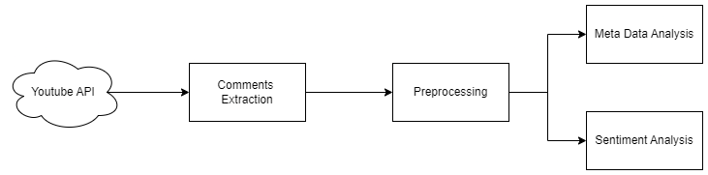
INTRODUCTION
This project aims to analyze sentiment and emotions in YouTube comments using natural language processing techniques.
The project consists of two main components:
Data Collection: Using the YouTube Data API, we fetch comments from a target video. The data includes information such as the author, publication date, like count, and the comment text itself.
Sentiment Analysis: We employ natural language processing tools to analyze the emotional content of the comments. This includes identifying positive, negative, and neutral sentiments, as well as more nuanced emotions like joy, anger, sadness, and surprise.

Slide 3
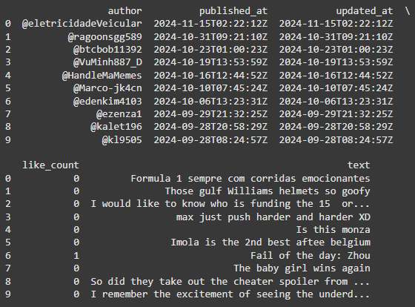
Methodology
Data Collection: The project uses the Google API Client Library for Python to interact with the YouTube Data API. An API client is initialized using a developer key, which allows access to YouTube's data.
Comment Retrieval: The `get_video_comments’ function is the core of the data collection process.
It takes a YouTube video ID and a target number of comments as input. The function iteratively fetches comments using the `fetch_comment_page’ helper function. Comments are extracted from the API response using the `extract_comments’ function.
Data Storage: Collected comments are stored in a list, with each comment represented as a list of attributes.
The data is then converted into a pandas DataFrame for easier manipulation and analysis.

Slide 4
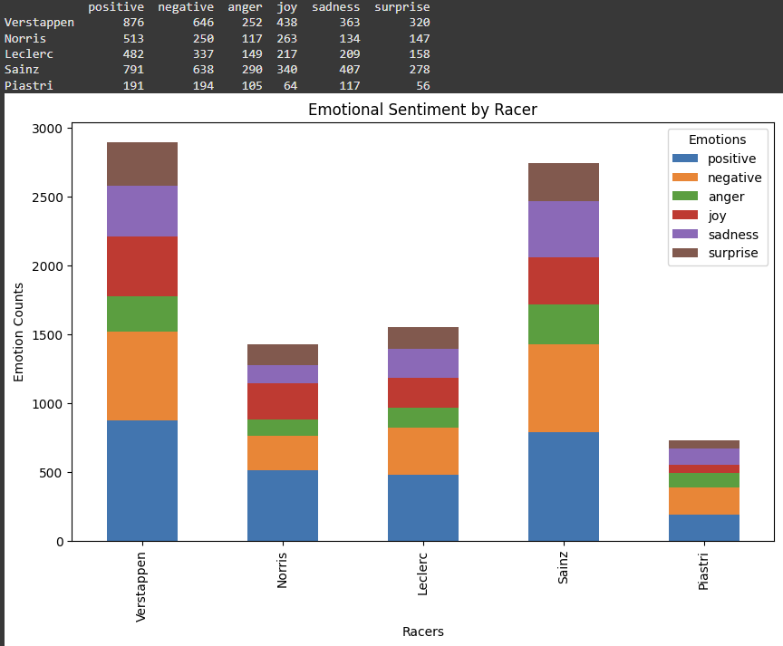
Data Processing and Analysis
Sentiment Analysis: The project uses the TextBlob library to perform sentiment analysis on the comments. Each comment's text is analyzed to determine its polarity (positive, negative, or neutral sentiment).
Emotion Detection: The NRCLex library is employed to identify emotions in the comments. This provides a more nuanced understanding of the emotional content beyond simple sentiment.
Data Visualization: The project uses matplotlib to create visualizations of the sentiment and emotion data. This includes bar charts showing emotional sentiment by specific topics or entities mentioned in the comments.
Targeted Analysis :The methodology includes focusing on specific topics or entities (e.g., racers in a Formula 1 video) to analyze sentiment and emotions associated with them.

Slide 5
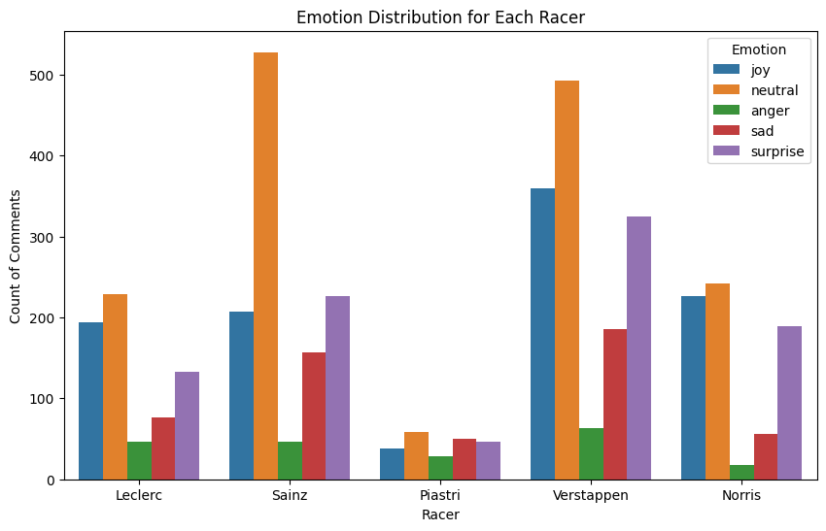
Results:
Emotional Sentiment by Racer
Verstappen: Received the highest number of emotional mentions across all categories, particularly in positive sentiment and joy. This suggests he was a focal point of discussion and generally viewed favorably by commenters.
Norris: Garnered substantial positive sentiment and joy mentions, indicating a generally positive reception among viewers.
Leclerc: Showed a mix of emotions, with notable positive sentiment but also significant negative and sadness mentions, suggesting a more polarized viewer response.
Sainz: Interestingly, had high counts across all emotional categories, including both positive and negative sentiments. This could indicate that he was involved in controversial or noteworthy events during the race.
Piastri: Had the lowest overall mention count among the analyzed racers, but showed a relatively balanced distribution of emotions, with slightly more negative than positive mentions.

Slide 6
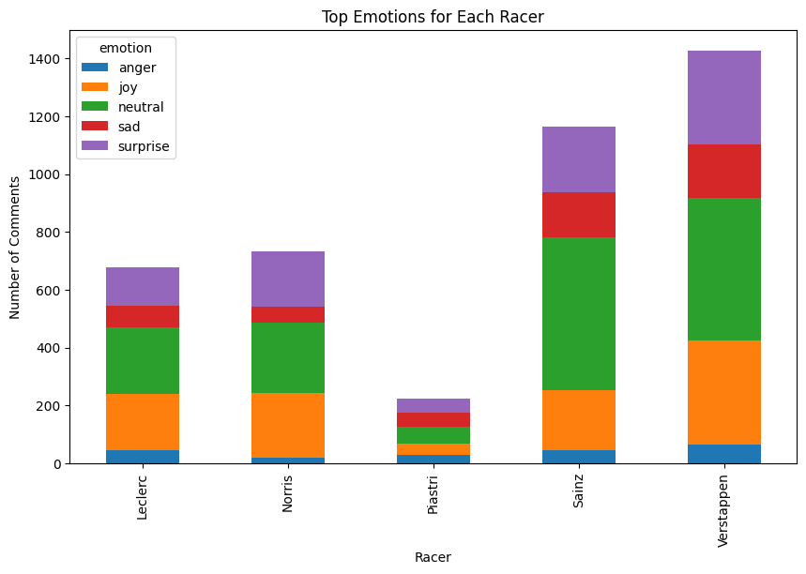
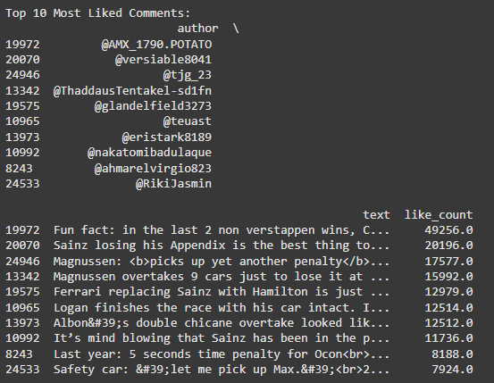
Overall Sentiment Distribution
The analysis revealed a mix of positive, negative, and neutral comments, with a slight bias towards positive sentiment overall.
This suggests that while the race generated diverse reactions, viewers generally had a more positive than negative experience.
User Engagement Patterns
Comments with higher like counts tended to express stronger emotions or provide particularly insightful observations, indicating that emotionally charged or informative comments resonated more with other viewers.
There was a correlation between the publication time of comments and their engagement levels, with comments posted shortly after the video's release generally receiving more likes.

Slide 7
Conclusion
In conclusion, this project demonstrates the power of combining data collection from social media platforms with advanced natural language processing techniques to gain valuable insights into user sentiment and engagement. By leveraging the YouTube Data API and various Python libraries, we successfully extracted and analyzed comments from a specific video, providing a comprehensive overview of viewer reactions and emotions.
The project's key accomplishments include:
Efficient data collection using the YouTube API, allowing for the extraction of thousands of comments along with relevant metadata.
Implementation of sentiment analysis using TextBlob, enabling the classification of comments into positive, negative, and neutral categories.
Advanced emotion detection through the NRCLex library, providing a nuanced understanding of the emotional content in viewer responses.
Targeted analysis of specific topics or entities mentioned in the comments, offering insights into audience perception of particular aspects of the video content.

